Slide 1
Unit 2
Classes and Objects

Slide 2
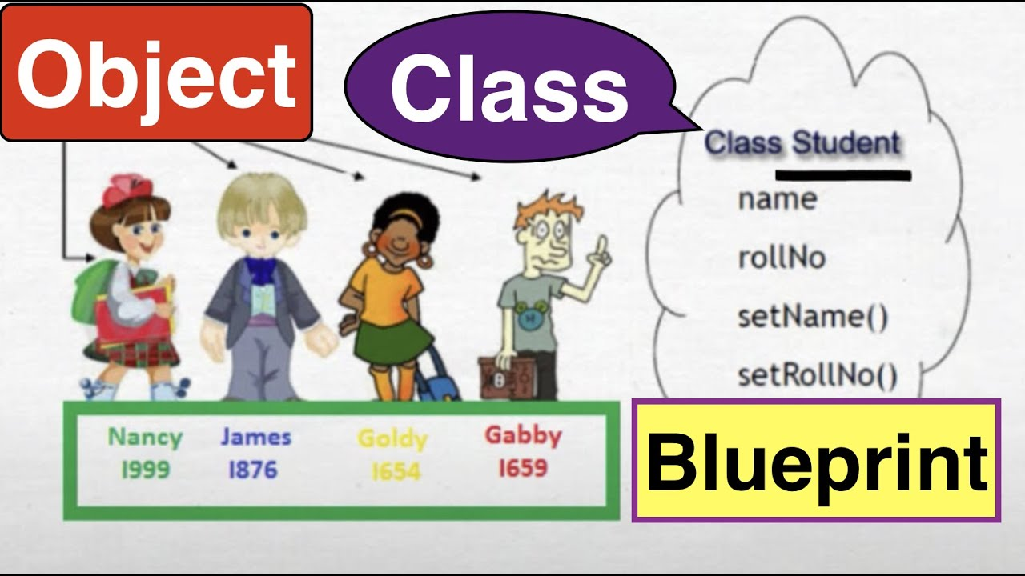
Introduction

Slide 3
C++ is an object-oriented programming language.
Everything in C++ is associated with classes and objects, along with its attributes and methods.
Attributes and methods are basically variables and functions that belongs to the class. These are often referred to as "class members".
A class is a user-defined data type that we can use in our program, and it works as a "blueprint" for creating objects.

Slide 4
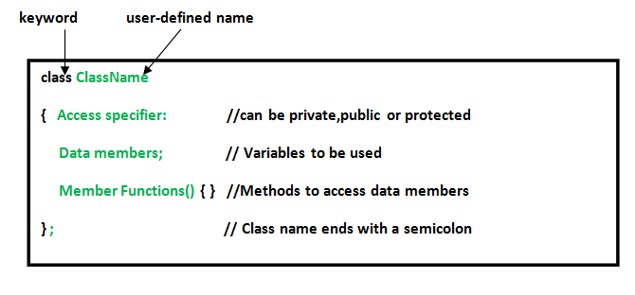
Specifying a class
A class is defined in C++ using keyword class followed by the name of class. The body of class is defined inside the curly brackets and terminated by a semicolon at the end.

Slide 5
Class Example
class MyClass { // The class public: // Access specifier int myNum; / Attribute (int var) string myString; // Attribute
};
The class keyword is used to create a class called MyClass.
The public keyword is an access specifier, which specifies that members (attributes and methods) of the class are accessible from outside the class.
Inside the class, there is an integer variable myNum and a string variable myString. When variables are declared within a class, they are called attributes.
At last, end the class definition with a semicolon ;.

Slide 6
Creating Objects
In C++, an object is created from a class.
Syntax –
Classname ObjectName;
To create an object of MyClass, specify the class name, followed by the object name.
Example
MyClass myObj;
To access the class attributes (myNum and myString), use the dot syntax (.) on the object:
myObj.myNum=20;

Slide 7
Example of Creating Objects
Class Bank
{
private:
int acno;
string name;
Int bal;
public:
Void get(){
Cin >> acno;
}
Void put(){
Cout << acno;
} };
Int main() {
Bank ob1;
ob1.get();
Ob1.put(); }

Slide 8
Access Specifiers
The public keyword is an access specifier. Access specifiers define how the members (attributes and methods) of a class can be accessed.
In C++, there are three access specifiers:
public - members are accessible from outside the class(main).
private - members cannot be accessed (or viewed) from outside the class. By default, all members of a class are private if you don't specify an access specifier.
protected - members cannot be accessed from outside the class, however, they can be accessed in inherited classes.

Slide 9
Access Specifiers Example
class MyClass { public: // Public access specifier int x; // Public attribute private: // Private access specifier int y; // Private attribute }; int main() { MyClass myObj; myObj.x = 25; // Allowed (public) myObj.y = 50; // Not allowed (private) return 0; }

Slide 10
Creating Multiple Objects
class Car { public: string brand; string model; int year; }; int main() { // Create an object of Car Car carObj1; carObj1.brand = "BMW"; carObj1.model = "X5"; carObj1.year = 1999; // Create another object of Car Car carObj2; carObj2.brand = "Ford"; carObj2.model = "Mustang"; carObj2.year = 1969; // Print attribute values cout << carObj1.brand << " " << carObj1.model << " " << carObj1.year << "\n"; cout << carObj2.brand << " " << carObj2.model << " " << carObj2.year << "\n"; return 0; }

Slide 11
www.menti.com
Code - 735152

Slide 12
Defining Member Function / Class Methods
Methods are functions that belongs to the class.
There are two ways to define functions that belongs to a class:
Inside class definition
Outside class definition

Slide 13
Inside Class Method Defining
class MyClass { // The class public: // Access specifier void myMethod() { // Method/function defined inside cout << "Hello World!"; } }; int main() { MyClass myObj; // Create an object of MyClass myObj.myMethod(); // Call the method return 0; }

Slide 14
Defining Method outside class
To define a function outside the class definition, you have to declare it inside the class and then define it outside of the class. This is done by specifiying the name of the class, followed the scope resolution :: operator, followed by the name of the function:
Syntax –
return type classname :: method_name(para_list)
{ statements}

Slide 15
Outside class method definition
class MyClass { // The class int a;
public: // Access specifier void myMethod(); // Method/function declaration }; // Method/function definition outside the class void MyClass::myMethod() { cout << "Hello World!"; } int main() { MyClass myObj; // Create an object of MyClass myObj.myMethod(); // Call the method return 0; }

Slide 16
Go to www.menti.com and
use the code 31 71 61

Slide 17
Method with Parameter
class MyClass {
public:
void myMethod(string name);
}; void MyClass::myMethod(string name) { cout << "Hello “ + name; } int main() { MyClass myObj;
myObj.myMethod(“Manaswini”);
return 0; }

Slide 18
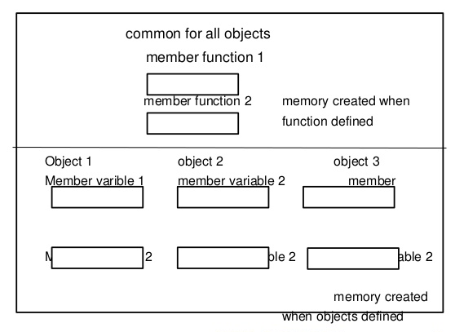
Memory allocation of Objects
Static variable

Slide 19
Memory allocation of Objects
The memory space is allocated to the data members of a class only when an object of the class is declared, and not when the data members are declared inside the class.
Since a single data member can have different values for different objects at the same time, every object declared for the class has an individual copy of all the data members.
On the other hand, the memory space for the member functions is allocated only once when the class is defined.
In other words, there is only a single copy of each member function, which is shared among all the objects.
For instance, the three objects, namely, book1, book2 and book3 of the class book have individual copies of the data members title and price.
However, there is only one copy of the member functions getdata () and putdata () that is shared by all the three objects

Slide 20
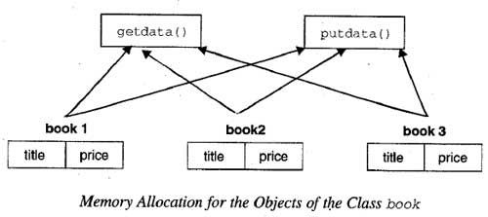
Int a; // global
Class BookClass
{
string title;
float price;
static int NoofBooks; // static
public:
Void getdata()
{
cin >> title>> price;
Noofbook++;
}
Void putdata()
{
cout << title << price;
}
};
Class Class2
{
// a accessible;
NoofBooks not accessible;
};
Int BookClass :: NoOfBooks;
Int main()
{
BookClass book1,book2,book3;
Book1.getdata();
Book2.getdata()
Book3.getData();
}
No of Books -3
3
OOP
120
JPR
DCO
150
130

Slide 21
Jamboard Activity

Slide 22
Static data member
We can define class members static using static keyword.
When we declare a member of a class as static it means no matter how many objects of the class are created, there is only one copy of the static member.
A static member is shared by all objects of the class. All static data is initialized to zero when the first object is created, if no other initialization is present.
We can't put it in the class definition but it can be initialized outside the class by redeclaring the static variable, using the scope resolution operator :: to identify which class it belongs to.

Slide 23
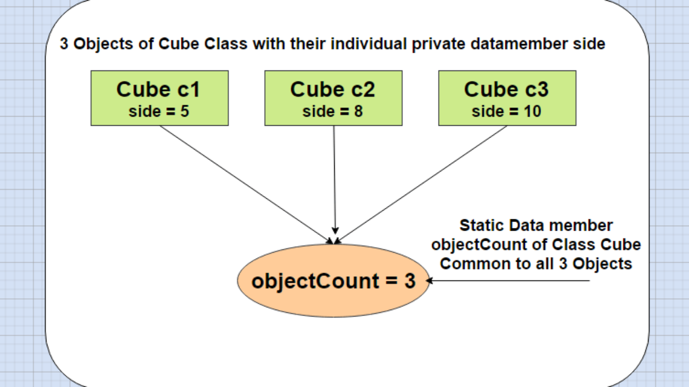

Slide 24
Example
class Box
{
public:
static int objectCount;
Box(double l = 2.0, double b = 2.0, double h = 2.0) {
cout <<"Constructor called." << endl;
length = l; breadth = b; height = h;
objectCount++;
}
double Volume() {
return length * breadth * height;
}
private:
double length,breadth, height;
};
int Box::objectCount = 0;
int main(void) {
Box Box1(3.3, 1.2, 1.5)
cout << "Total objects: " << Box::objectCount << endl;
return 0; }

Slide 25
Static Member Function
By declaring a function member as static, you make it independent of any particular object of the class.
A static member function can be called even if no objects of the class exist and the static functions are accessed using only the class name and the scope resolution operator ::

Slide 26
Static Member Function
A static member function can only access static data member, other static member functions and any other functions from outside the class.
Static member functions have a class scope and they do not have access to the this pointer of the class.

Slide 27
Example
Class Demo
{
Static int a;
Int b;
Public:
Static Void display()
{
cout << a;
b
}
Void get()
{
}
};
Int Demo :: a;
Int main()
{
Demo :: display();
Demo d;
D.get();
}

Slide 28
Friend Function
A friend function of a class is defined outside that class' scope but it has the right to access all private and protected members of the class. Even though the prototypes for friend functions appear in the class definition, friends are not member functions.
To declare a function as a friend of a class, precede the function prototype in the class definition with keyword friend

Slide 29
class Box {
double width;
public: double length;
friend void printWidth( Box box );
void setWidth( double wid );
};
void printWidth( Box box ) {
cout << "Width of box : " << box.width <<endl; }
int main() { Box box;
box.setWidth(10.0);
printWidth( box ); return 0; }

Slide 30
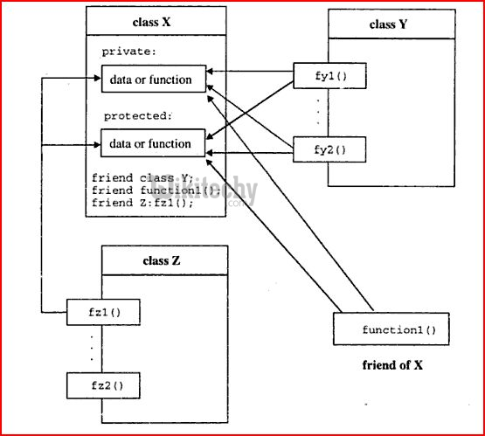

Slide 31
Activity on Google Slides

Slide 32
Array of Objects
Like array of other user-defined data types, an array of type class can also be created.
An array of objects is declared in the same way as an array of any built-in data type.
Syntax –
class_name array_name [size] ;
Student st[5];
Student s1,s2,s3,s4,s5;

Slide 33
Example of Array Objects
Return type function_name(datatype var1,datatype var2)
{
}
class MyClass {
int x;
public:
void setX(int i)
{ x = i; }
int getX() { return x; }
};
void main() {
MyClass obs[4];
int i;
Obs[0].setX(3);
Obs[1].setX(4);
Obs[2].setX(5);
Obs[3].setX(6);
Cout << obs[0].getX();
Cout << obs[1].getX() << obs[2].getX() << obs[3].getX();
getch();
}

Slide 34
Object as function argument
To pass an object as an argument we write the object name as the argument while calling the function the same way we do it for other variables.
Syntax –
Datatype function_name(classname object_name) //declaration /define
{
statement;
}
Object.function_name(objectname); // calling

Slide 35
Example
class Example {
public:
int a;
void getA()
{
cout << “Enter the value ”;
cin >> a;
}
void add(Example E1) {
a = a + E1.a;
} };
int main() {
Example E1, E2;
E1.getA();
E2.getA();
cout << "Initial Values \n";
cout << "Value of object 1: " << E1.a << "\n& object 2: " << E2.a << "\n\n";
E2.add(E1);
cout << "New values \n";
cout << "Value of object 1: " << E1.a << "\n& object 2: " << E2.a << "\n\n";
return 0;
}

Slide 36
Constructor
A constructor is a member function of a class which initializes objects of a class.
In C++, Constructor is automatically called when object(instance of class) create.
It is special member function of the class.

Slide 37
Features of constructor
Constructor has same name as the class itself
Constructors don’t have return type
A constructor is automatically called when an object is created.
If we do not specify a constructor, C++ compiler generates a default constructor for us (expects no parameters and has an empty body).

Slide 38
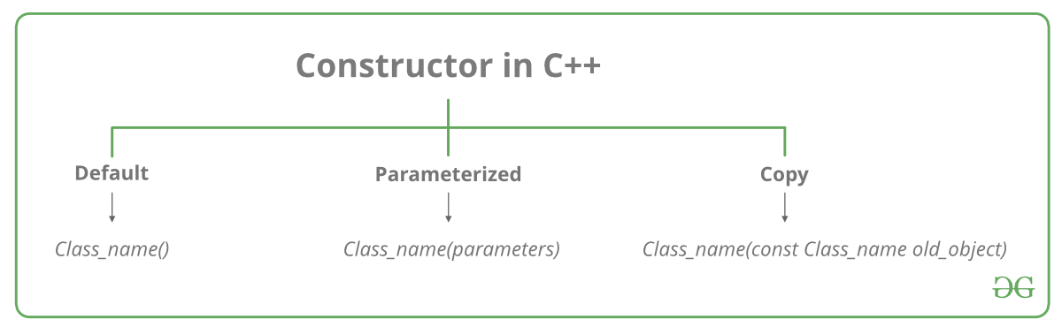
Types of constructor

Slide 39
Default constructor
Default constructor is the constructor which doesn’t take any argument.
It has no parameters.

Slide 40
Default constructor - Example
class Point {
public:
int x, y;
// Default Constructor
construct()
{
x = 10;
y = 20;
}
};
int main()
{
Point p;
cout << “x: " << p.x << endl
<< “y: " << p.y;
return 0;
}

Slide 41
Parameterized Constructor
It is possible to pass arguments to constructors. Typically, these arguments help initialize an object when it is created.
To create a parameterized constructor, simply add parameters to it the way you would to any other function.
When you define the constructor’s body, use the parameters to initialize the object.

Slide 42
Parameterized Constructor - Example
int main()
{
Point p1(10, 15);
cout << "p1.x = " << p1.getX() << ", p1.y = " << p1.getY();
return 0;
}
class Point {
private:
int x, y;
public:
Point(int x1, int y1) {
x = x1;
y = y1;
}
int getX() {
return x;
}
int getY() {
return y;
}
};

Slide 43
Copy Constructor
A copy constructor is a member function which initializes an object using another object of the same class.
ClassName (ClassName old_obj);

Slide 44
Copy Constructor – Example
class Point
{
private:
int x, y;
public:
Point(int x1, int y1) { x = x1; y = y1; }
Point(Point p2) {x = p2.x; y = p2.y; }
int getX() { return x; }
int getY() { return y; }
};
int main()
{
Point p1(10, 15);
Point p2 = p1;
cout << "p1.x = " << p1.getX() << ", p1.y = " << p1.getY();
cout << "\np2.x = " << p2.getX() << ", p2.y = " << p2.getY();
return 0;
}

Slide 45
Multiple Constructors in a Class
We can have more than one constructor in a class with same name, as long as each has a different list of arguments.
This concept is known as Constructor Overloading
Overloaded constructors essentially have the same name (name of the class) and different number of arguments.
A constructor is called depending upon the number and type of arguments passed.
While creating the object, arguments must be passed to let compiler know, which constructor needs to be called.

Slide 46
Multiple constructor Example
int main()
{
construct o;
construct o2( 10, 20);
o.disp();
o2.disp();
return 1;
}
class construct
{
public:
float area;
construct()
{
area = 0;
}
construct(int a, int b)
{
area = a * b;
}
void disp()
{
cout<< area<< endl;
}
};

Slide 47
Destructor in C++
Destructor is a member function which destructs or deletes an object.
Destructors have same name as the class preceded by a tilde (~). Destructors don’t take any argument and don’t return anything
When is destructor called? A destructor function is called automatically when the object goes out of scope:

Slide 48
there can only one destructor in a class with classname preceded by ~, no parameters and no return type.

Slide 49
Destructor in C++
#include <iostream>
using namespace std;
class HelloWorld{
public:
HelloWorld(){
cout<<"Constructor is called"<<endl;
}
~HelloWorld(){
cout<<"Destructor is called"<<endl;
}
void display(){
cout<<"Hello World!"<<endl;
}
};
int main(){
HelloWorld obj;
obj.display();
return 0;
}

Slide 50
Rules for Destructor
1) Name should begin with tilde sign(~) and must match class name. 2) There cannot be more than one destructor in a class. 3) Unlike constructors that can have parameters, destructors do not allow any parameter. 4) They do not have any return type, just like constructors. 5) When you do not specify any destructor in a class, compiler generates a default destructor and inserts it into your code.

Slide 51
class Count{
static int c;
public: Count() {
c++;
cout << "No of Objects " << c << endl;
}
~Count() {
c--;
cout << "No of Objects " << c << endl;
}
};
int Count :: c;
int main(){
Count c1; {
Count c2; {
Count c3; }
}
}

